Slide 1
IBM University Engagement Project Submission
“Exploring the Power of Agentic AI with IBM Granite and IBM Bob”

Slide 2

Project Tile – Interview Trainer Agent
Domain of Project – Education
Student Name | Recent Passport Photo | Email ID | Mobile number [WhatsApp]
SHUBHAMKUMAR THAKOR |  | thakorshubham548@gmail.com | +91 9727096287
Recommended font style and size: Font Style: Arial Font Size (Heading): 28
Font Size (Content): 20

Slide 3
Problem Statement -
Problem Statement : Interview Trainer Agent
The Challenge
An Interview Trainer Agent, powered by RAG (Retrieval-Augmented Generation), prepares users for job interviews by generating tailored question sets and preparation strategies based on their profile name, experience level, and job role.
It retrieves role-specific interview questions, industry expectations, behavioral scenarios, and HR guidelines from recruitment portals, professional networks, and company interview databases.
Users can input their resume or job title, and the agent provides targeted questions, model answers, and improvement tips.
It supports both technical and soft skill assessment, ensuring a comprehensive interview prep experience. This AI-driven assistant builds user confidence, sharpens responses, and increases success rates in competitive hiring environments.
The Objectives:
To provide personalized interview preparation based on the user's profile, experience level, and target job role.
To generate role-specific interview questions covering technical, HR, behavioral, and situational aspects.
To use RAG (Retrieval-Augmented Generation) to retrieve relevant interview questions, industry expectations, and company-specific information.
To integrate IBM Granite for generating accurate and context-aware interview responses.
To provide model answers that help users understand how to structure and present their responses effectively.

Slide 4
Proposed Solution -
Proposed Solution: Interview Trainer Agent
Develop an AI-Powered Interview Trainer Agent using RAG and IBM Granite.
Accept resume, job role, skills, and experience level as user inputs.
Retrieve role-specific questions, industry expectations, HR guidelines, and behavioral scenarios from a knowledge base.
Use IBM Granite to generate personalized interview questions and model answers.
Conduct technical, HR, and behavioral mock interviews.
Analyze user responses and provide instant feedback and improvement tips.
Generate a personalized interview preparation strategy.
Help users improve confidence, communication, and interview performance.

Slide 5
Technology Used
Technology Used
IBM Cloud Lite
IBM Granite Foundation Model
RAG (Retrieval-Augmented Generation)
Python
LangChain
Vector Database
Natural Language Processing (NLP)
HTML, CSS & JavaScript
REST APIs
Git & GitHub

Slide 6
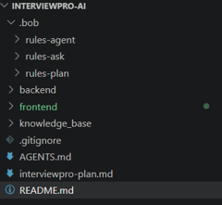
Required Files created using IBM bob -
App.py
Requirements.txt
Style.css
.env
Index.html

Slide 7
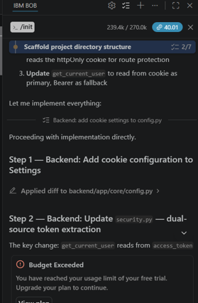
IBM Bob Screenshots:

Slide 8
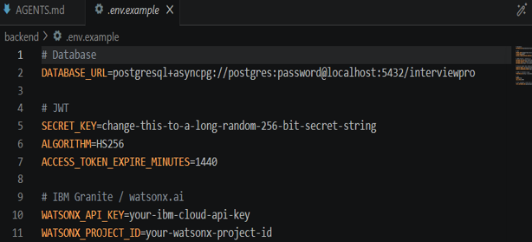

Slide 9
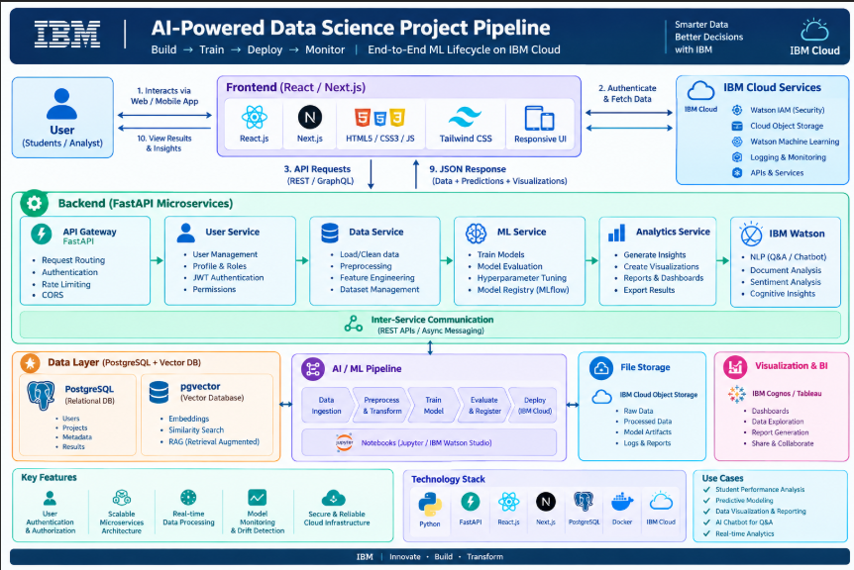
Architecture blueprint for IBM bob:

Slide 10

Role of Agentic AI in the solution
Understands User Profile: Analyzes resume, skills, experience, and target job role.
Intelligent Retrieval: Retrieves relevant interview questions and industry information using RAG.
Personalized Question Generation: Creates customized technical, HR, and behavioral questions.
Mock Interview Agent: Conducts an interactive interview and adapts questions based on user responses.
Answer Evaluation: Analyzes responses and identifies strengths and weaknesses.
Real-Time Feedback: Provides model answers, corrections, and improvement suggestions.
Goal: Acts as a personal AI interview coach to improve confidence and interview readiness.

Slide 11

Token Usage
239.4k token are used
After the Prompt

Slide 12
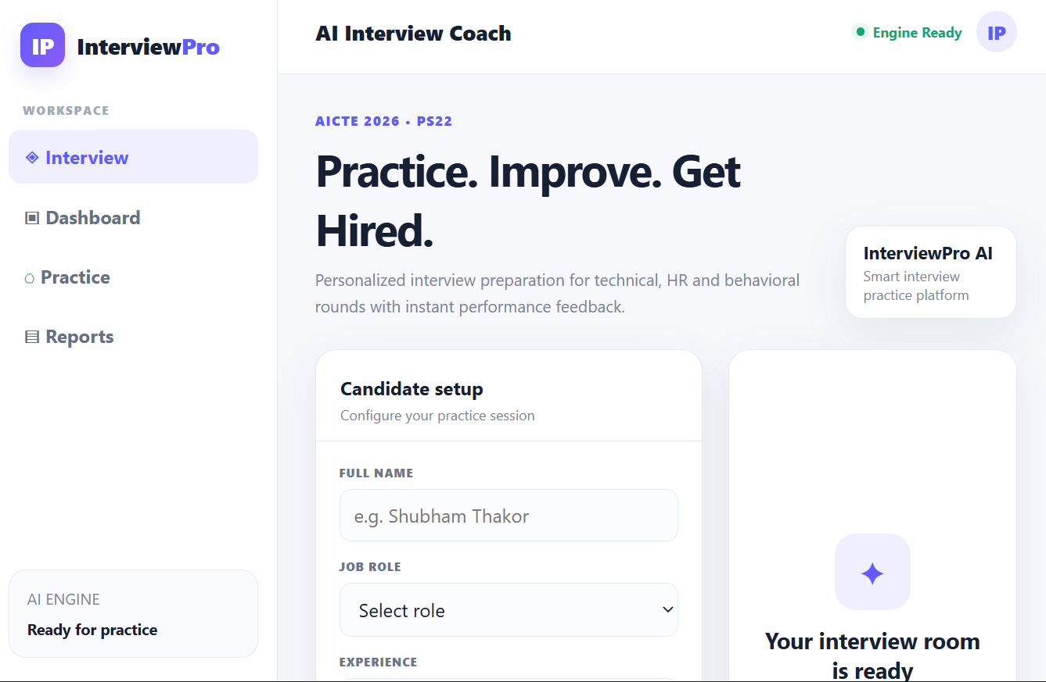
Project Output Screenshot
·
·
·

Slide 13
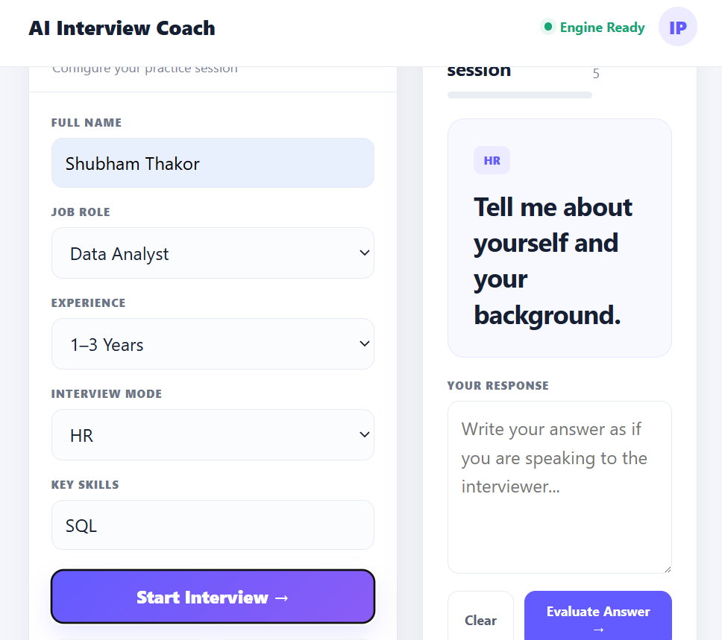
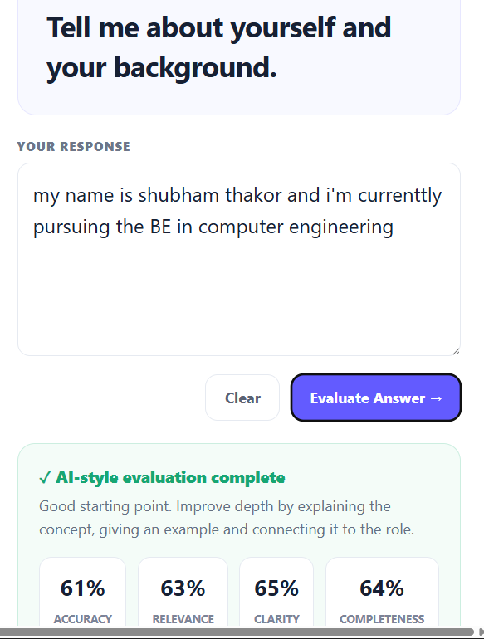
Project Output Screenshot
·
·
·

Slide 14
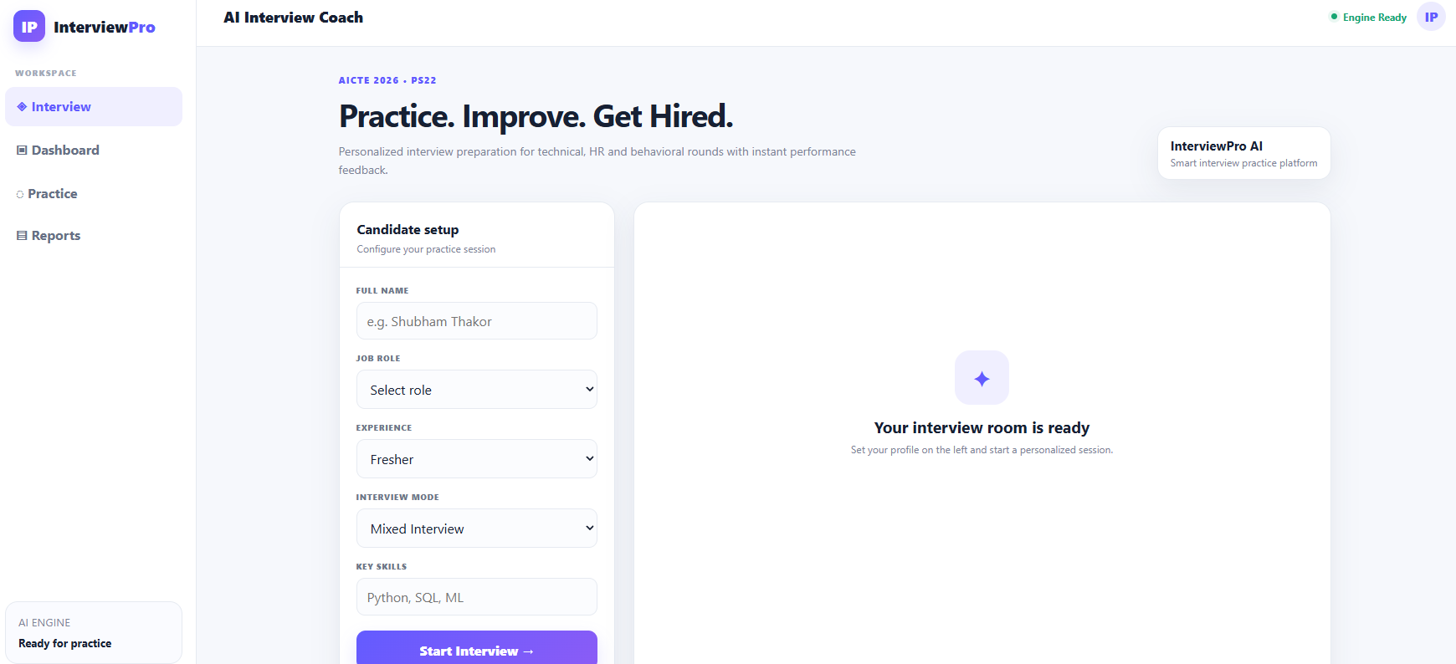
Project Output Screenshot
·
·
·

Slide 15
Novelty and Uniqueness
Personalized AI Interview Coach tailored to each user's resume, skills, experience, and target role.
RAG-Based Responses provide relevant and context-aware questions instead of generic interview content.
AI-Powered Answer Evaluation identifies weaknesses and provides personalized improvement suggestions.
Role & Industry-Specific Preparation focuses on the skills and expectations relevant to the selected job.
IBM Granite Integration enhances the system with enterprise-grade generative AI capabilities.
Continuous Improvement tracks performance and recommends topics that require more preparation.

Slide 16
Git Hub Link
· Please create public github repository (Enable Add README button while creating repository) with format –
Please test and Paste the working Github URL – https://github.com/shubham0182/Interview-Trainer-Agent.git
Make sure you have Uploaded following three files into your github repository 1) All Agent relevant files of IBM Cloud , 2) yourproblemstatement.pdf file 3) your projectpresntation.pptx file 4)any other files
·
·
·

Slide 17
Future Scope
Voice-Based Interviews: Add speech recognition and voice interaction for realistic mock interviews.
Multilingual Support: Support multiple Indian and international languages.
Company-Specific Preparation: Provide interview preparation based on specific companies and their hiring patterns.
ATS Resume Analysis: Analyze resumes for ATS compatibility and suggest improvements.
Job Description Matching: Compare a user's resume with a job description and generate targeted preparation.
Personalized Learning Plans: Automatically create daily/weekly interview preparation plans.
Industry Expansion: Extend the system to different domains such as IT, finance, healthcare, marketing, and engineering.
Mobile Application: Develop a mobile version for interview preparation anytime and anywhere.
·
·
·

Slide 18
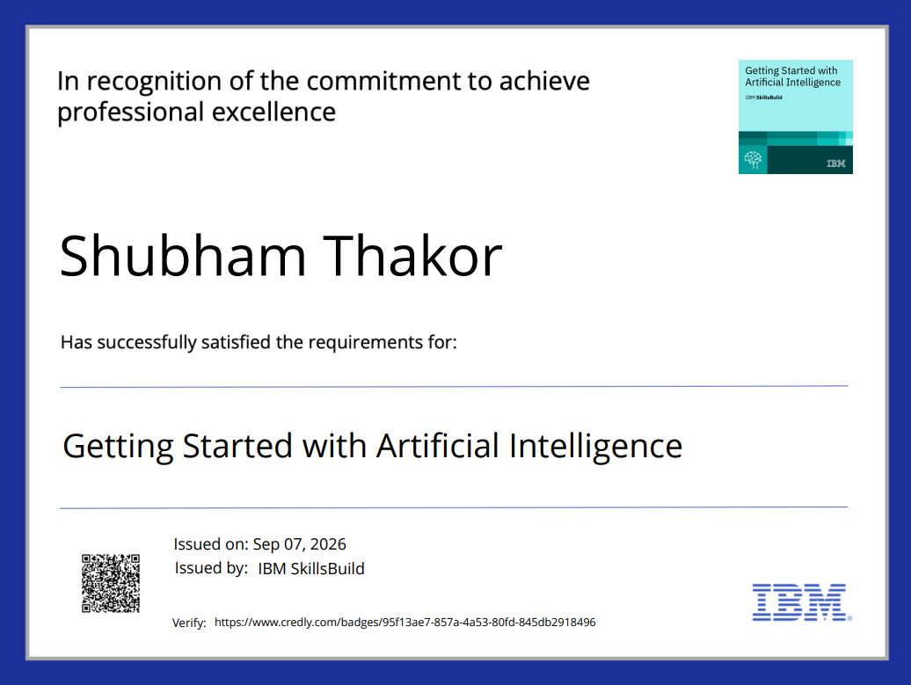
Certificates Earned:
Please add your credly certificate(Getting Started with Artificial Intelligence)

Slide 19
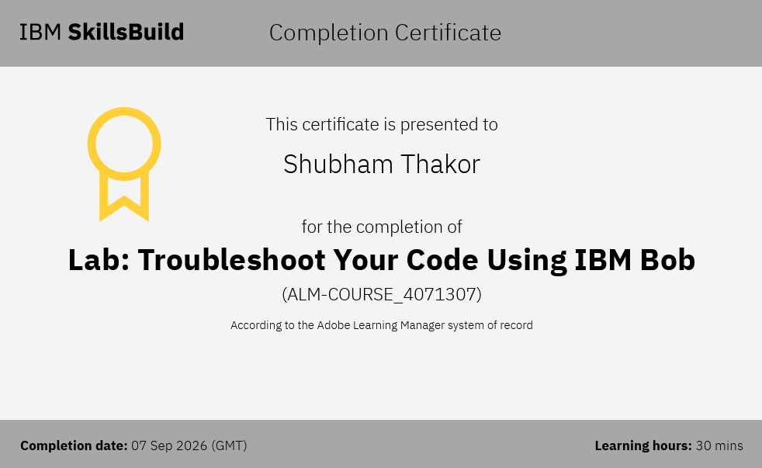
Certificates Earned:​
Add your IBM BOB Certificate

Slide 20


